Slide 1
iPredator
Information Age Dark Side of Human Consciousness

Slide 21
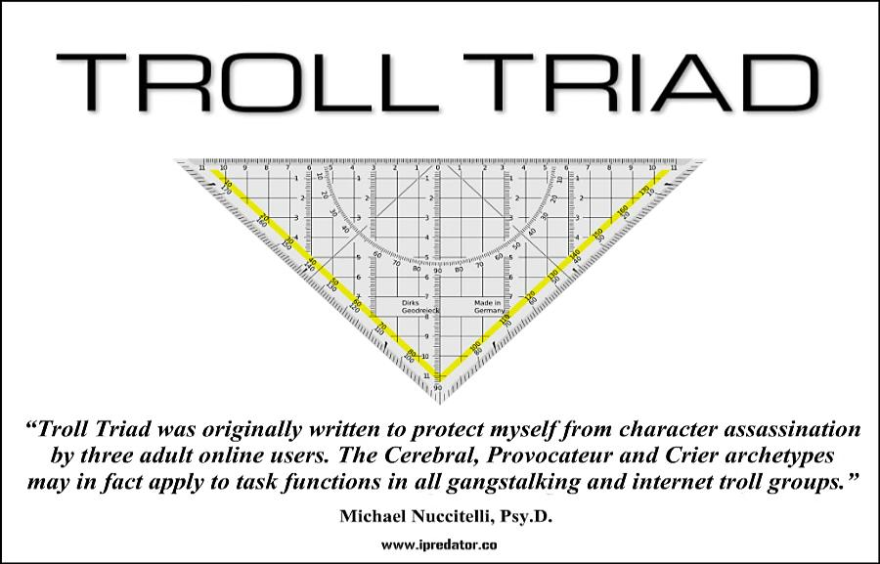

Slide 79
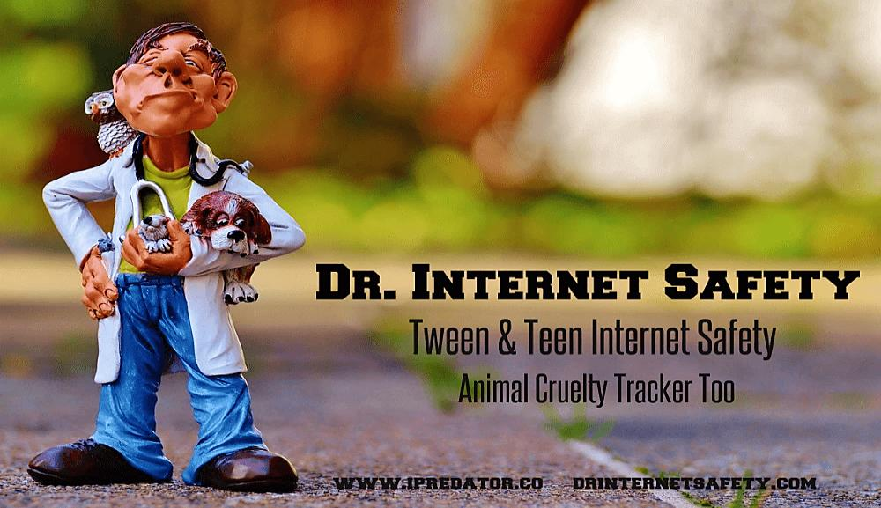

Slide 87
